Slide 2
Notes:
A fictitious Case Study: The Quayside Benefice

Slide 3
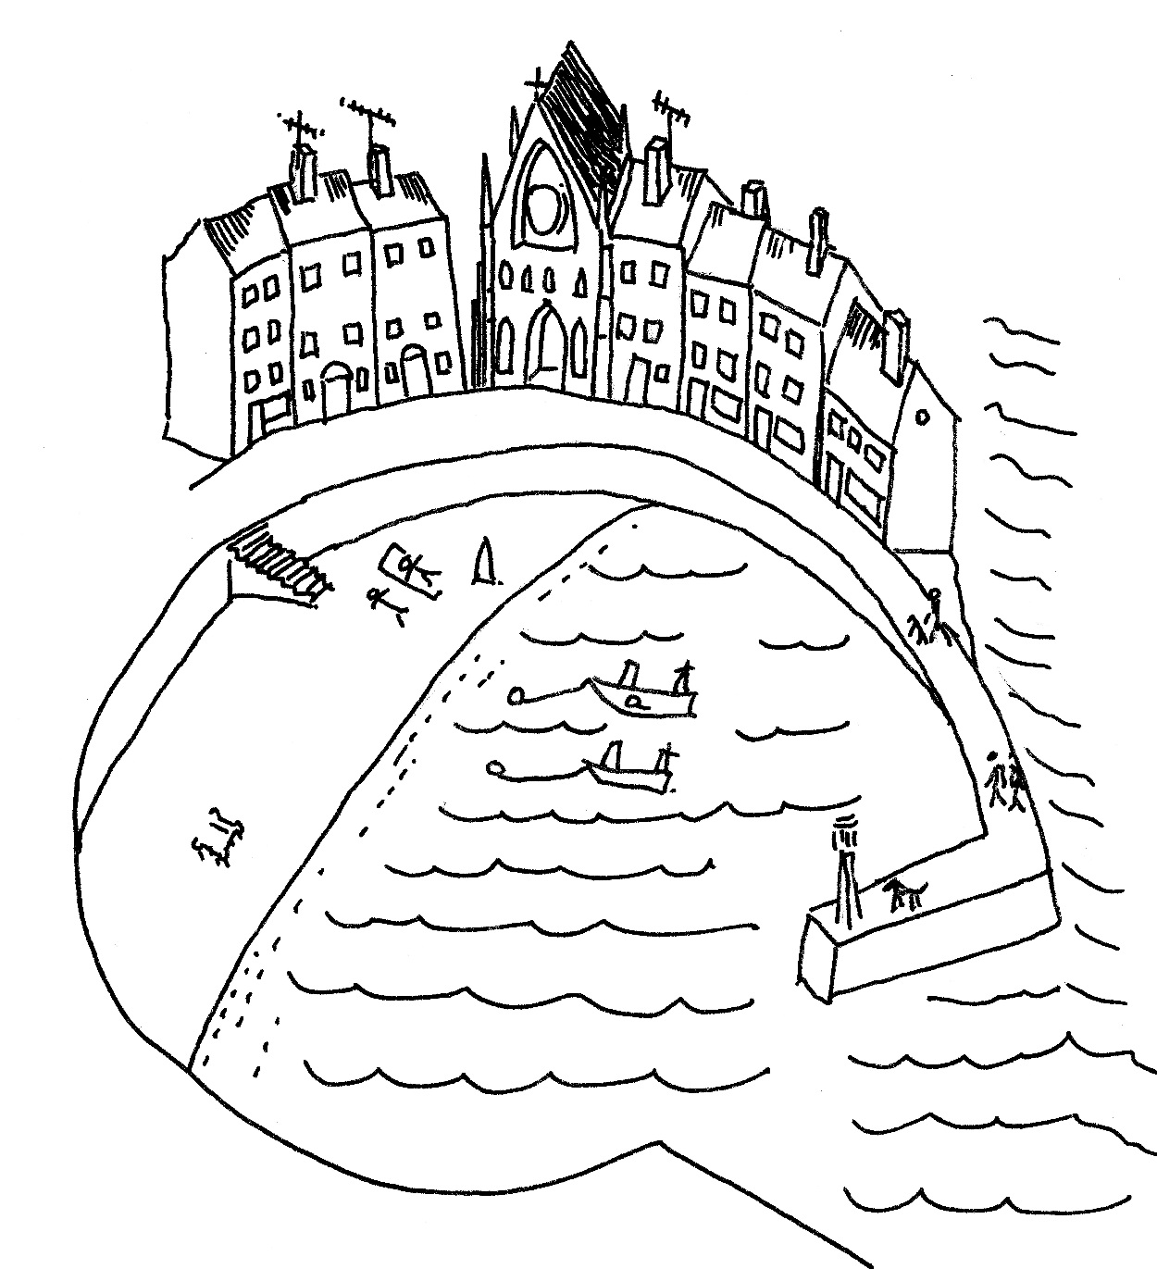
Notes:
The Quayside Benefice has been growing and discovering in all sorts of ways since it was formed.

Slide 4
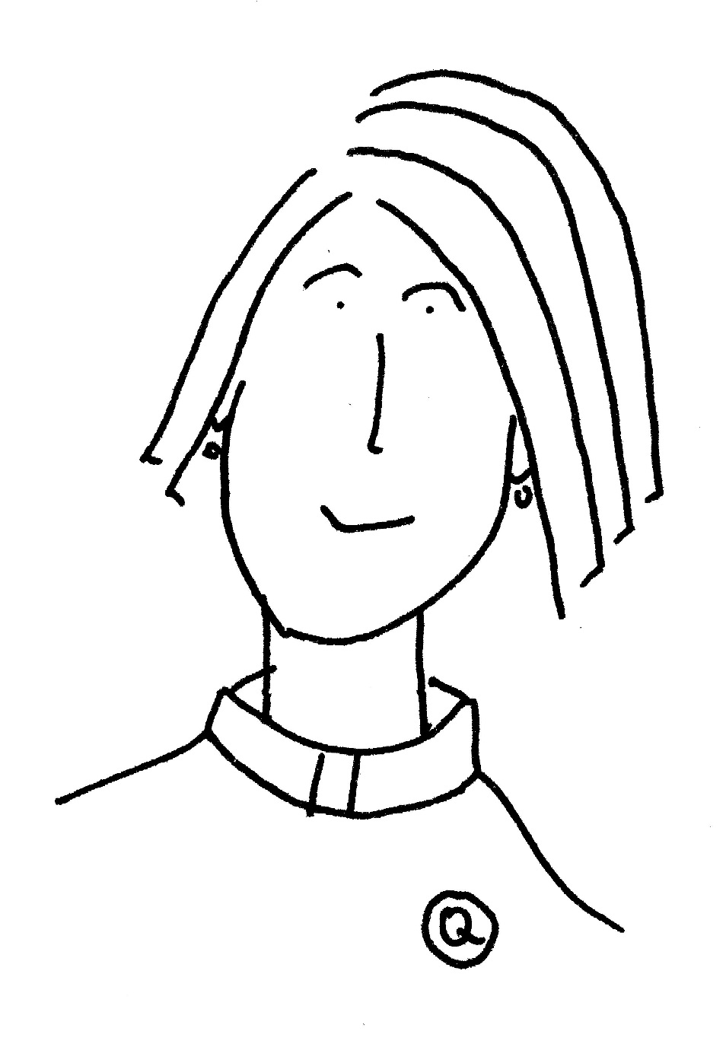
Notes:
The incumbent asked to participate in Accompanied Ministry Development (AMD) .

Slide 5
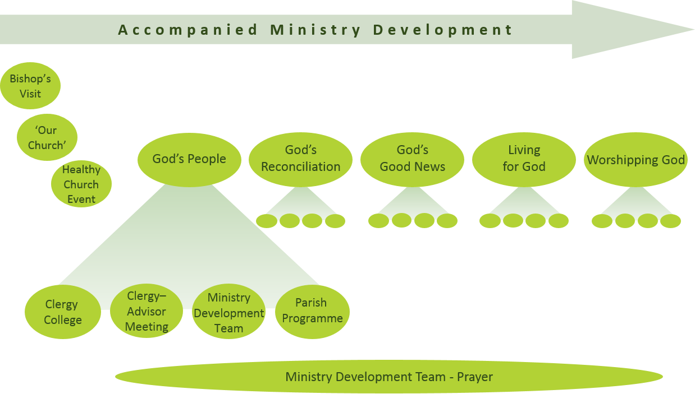

Slide 6
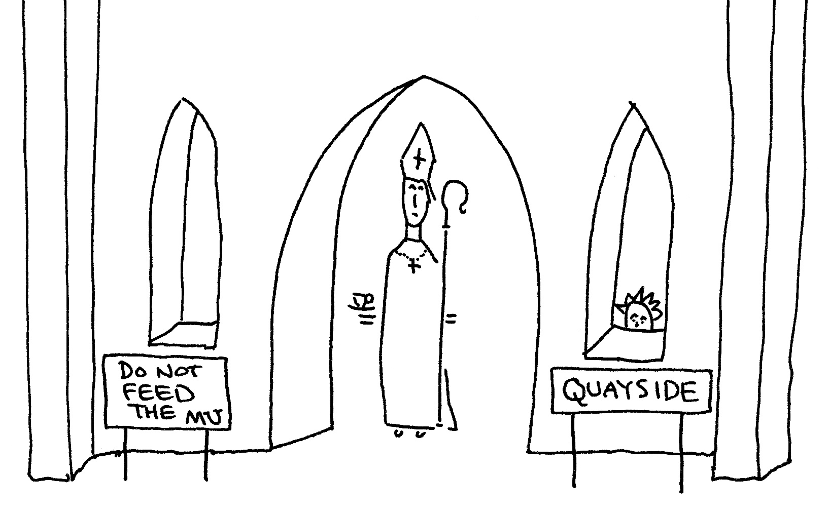
Bishop’s
Visit
Notes:
Soon afterwards the bishop visited the parish to explain what is involved.

Slide 7
‘Our
Church’
Survey
Notes:
AMD is a spiritual journey that starts in one place and ends up in another. To see what terrain has been covered the benefice uses the ‘Departure Point’ survey to find out what prayer is happening in the churches and how people are engaged in the community right at the beginning of the journey. (They could also have looked at other features of church life).

Slide 8
Clergy
College
Notes:
The priest was a little apprehensive about meeting colleagues at the first Clergy College, but enjoyed the presenters and soon discovered that the Colleges were excellent Professional Development. She found the Action Learning Group discussions with other incumbents especially helpful – they helped her work out how to link the Colleges with what went on the benefice.

Slide 9
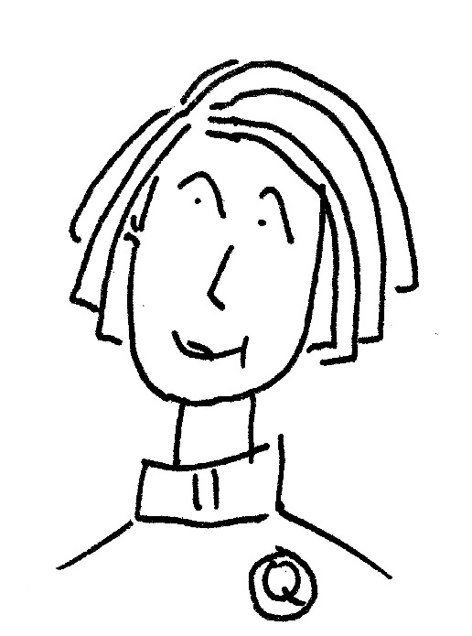
Clergy-
Advisor
Meeting
Notes:
The AMD Advisor who met with her a week or so after the College to help her reflect on what went on was also a great support.

Slide 10
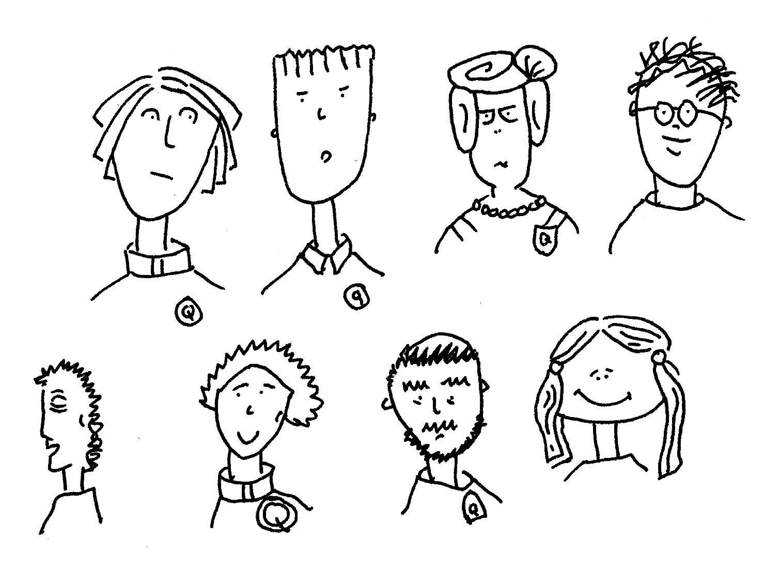
Ministry
Development
Team
Notes:
The priest had gathered a Ministry Development Team from the benefice to look at the same themes as the Colleges. These are God’s People, God’s Reconciliation, God’s Good News, Living for God and Worshiping God. Having other people in the benefice who knew about the themes meant the priest was not a ‘voice in the wilderness’. And the group gave coherence to spiritual leadership within the benefice.

Slide 11
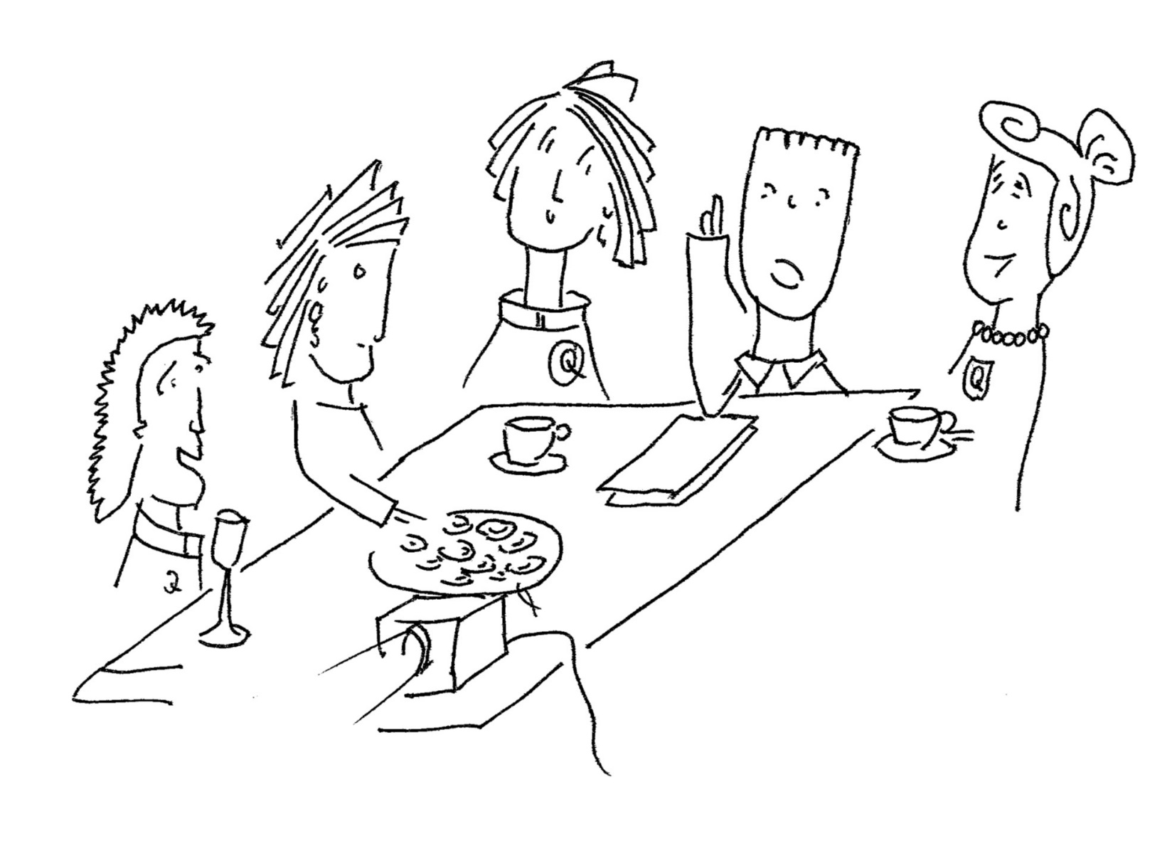
Parish
Programme
Notes:
The Parish Programme provided new resources for small groups, youth work and worship, all available on-line. Many were produced or coordinated by Church House staff. People said it was great to be able to talk about their faith in new ways.

Slide 12
Notes:
During the first year of AMD, the benefice clergy and lay leaders were especially drawn to the idea of ‘welcome,’ one of the topics touched upon during a Clergy College. They also decide to start a ‘Messy Church,’ and work among students with the neighbouring parish.

Slide 13
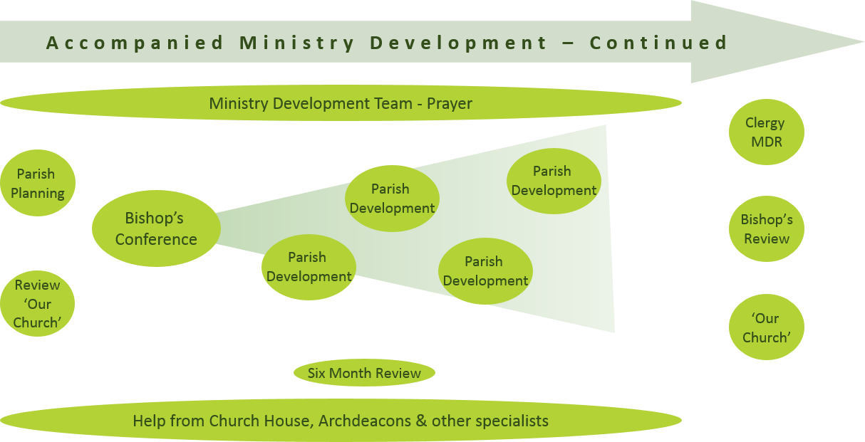

Slide 14
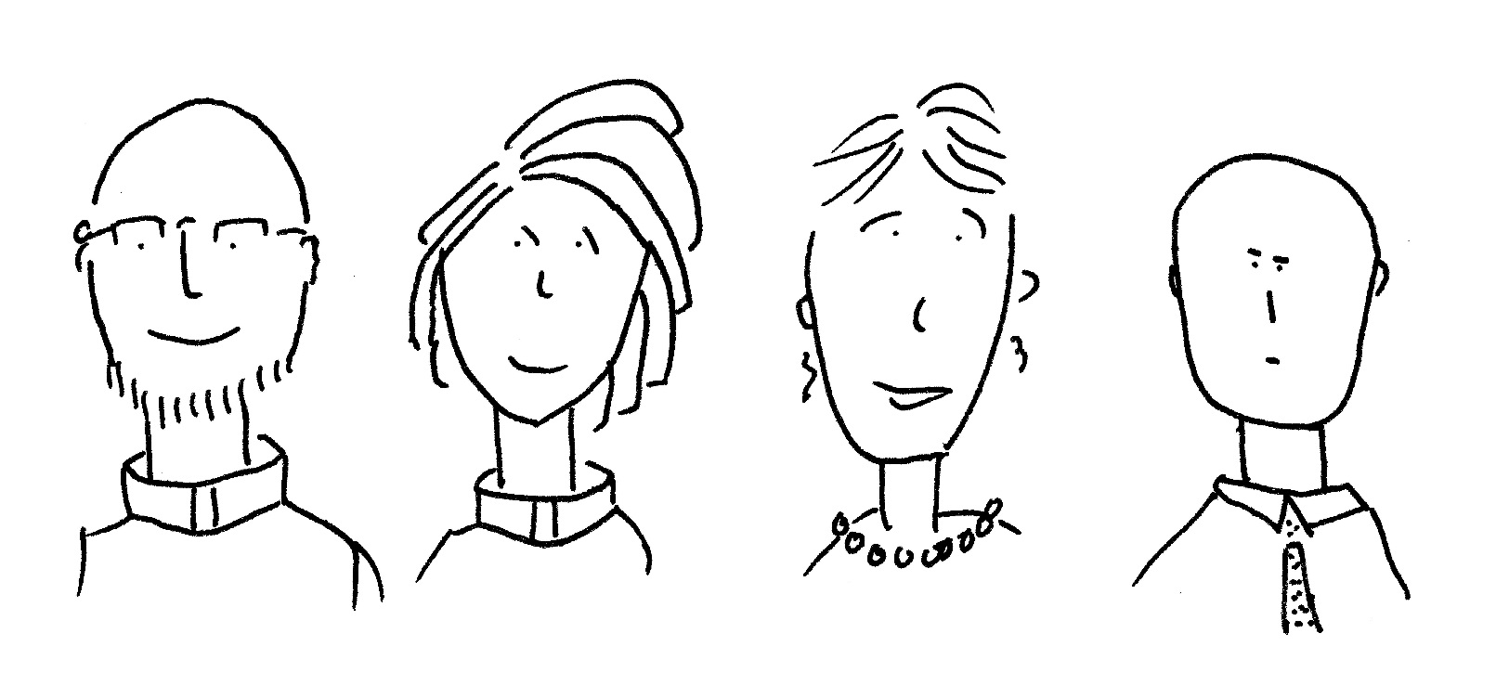
Parish
Planning
Notes:
At the beginning of Parish Planning, the priest and the benefice Ministry Development Team meet with the Archdeacon of Cornwall and a member of Church House. The benefice say that they already have the resources to develop their welcome over the next few months, but that they need help with Messy Church and student outreach.

Slide 15
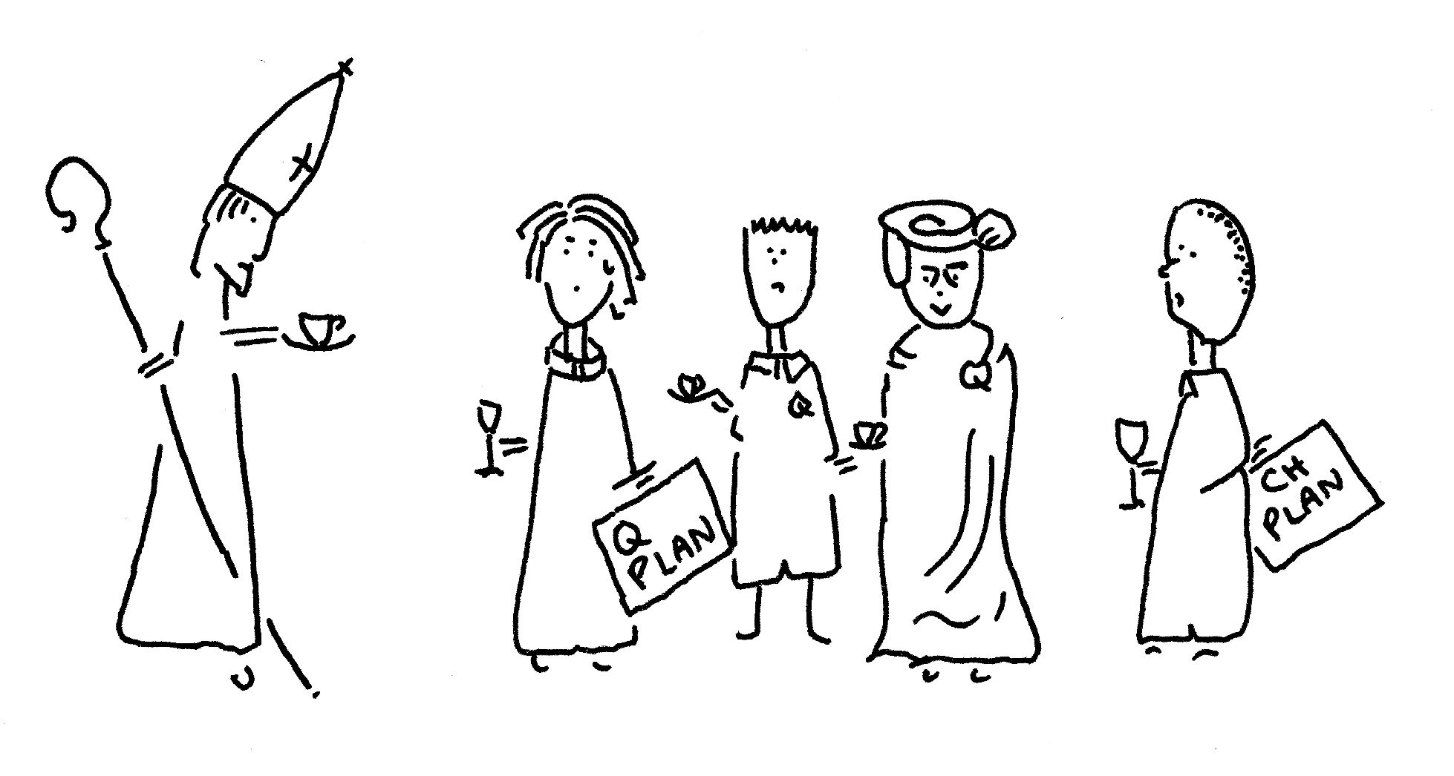
Bishop’s
Conference
Notes:
For the Bishop’s Conference the Church House team agrees training and resources for Messy Church (the resources funded by the benefice in this case; the training sourced by the diocese). At the meeting, the benefice agree a launch date for Messy Church and the ‘welcome’ work. The Bishop, however, gently challenges the benefice to be more ambitious and specific about the impact of their ‘welcome’ initiatives; the plans are revised and agreed at the Bishop’s Conference.

Slide 16
Parish
Development
Notes:
As a result of good Parish Planning, everyone recognises that lots of input and coordination within the deanery is necessary if the student outreach is to be successful. The Bishop’s Conference agrees the action and timetable for the individual churches, benefice, deanery and diocese.
The Head of Church Growth Development coordinates the consultants required to deliver the agreed support. The benefice embarks upon their chosen Parish Projects (welcome, Messy Church and student outreach).

Slide 17
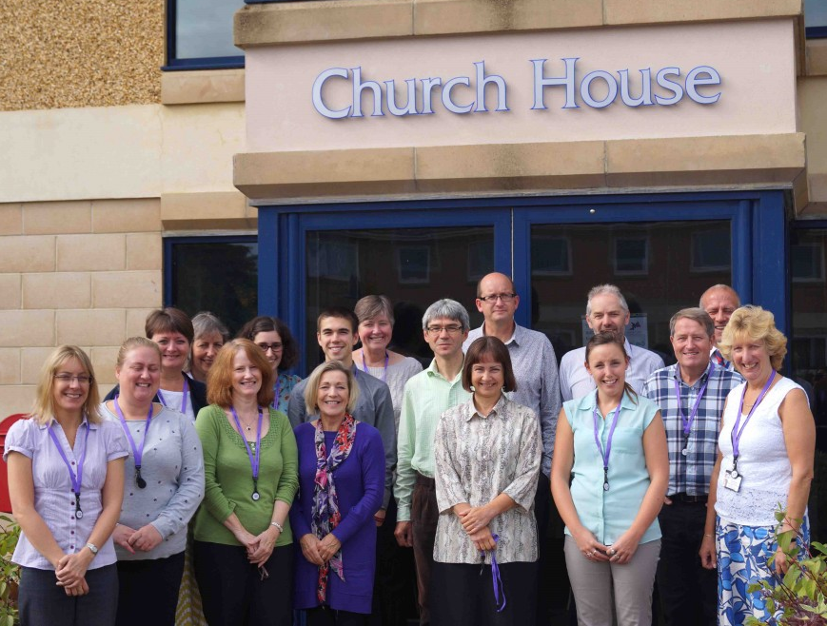
Help From
Church House
Notes:
The Archdeacon of Cornwall takes a particular interest in the joint planning for student outreach, which is also supported by Church House and works with a neighbouring parish. The Messy Church project is supported by the Discipleship Team, which visits the benefice three times over the year (once to help plan and train, to accompany the first event, and then to refine).

Slide 18
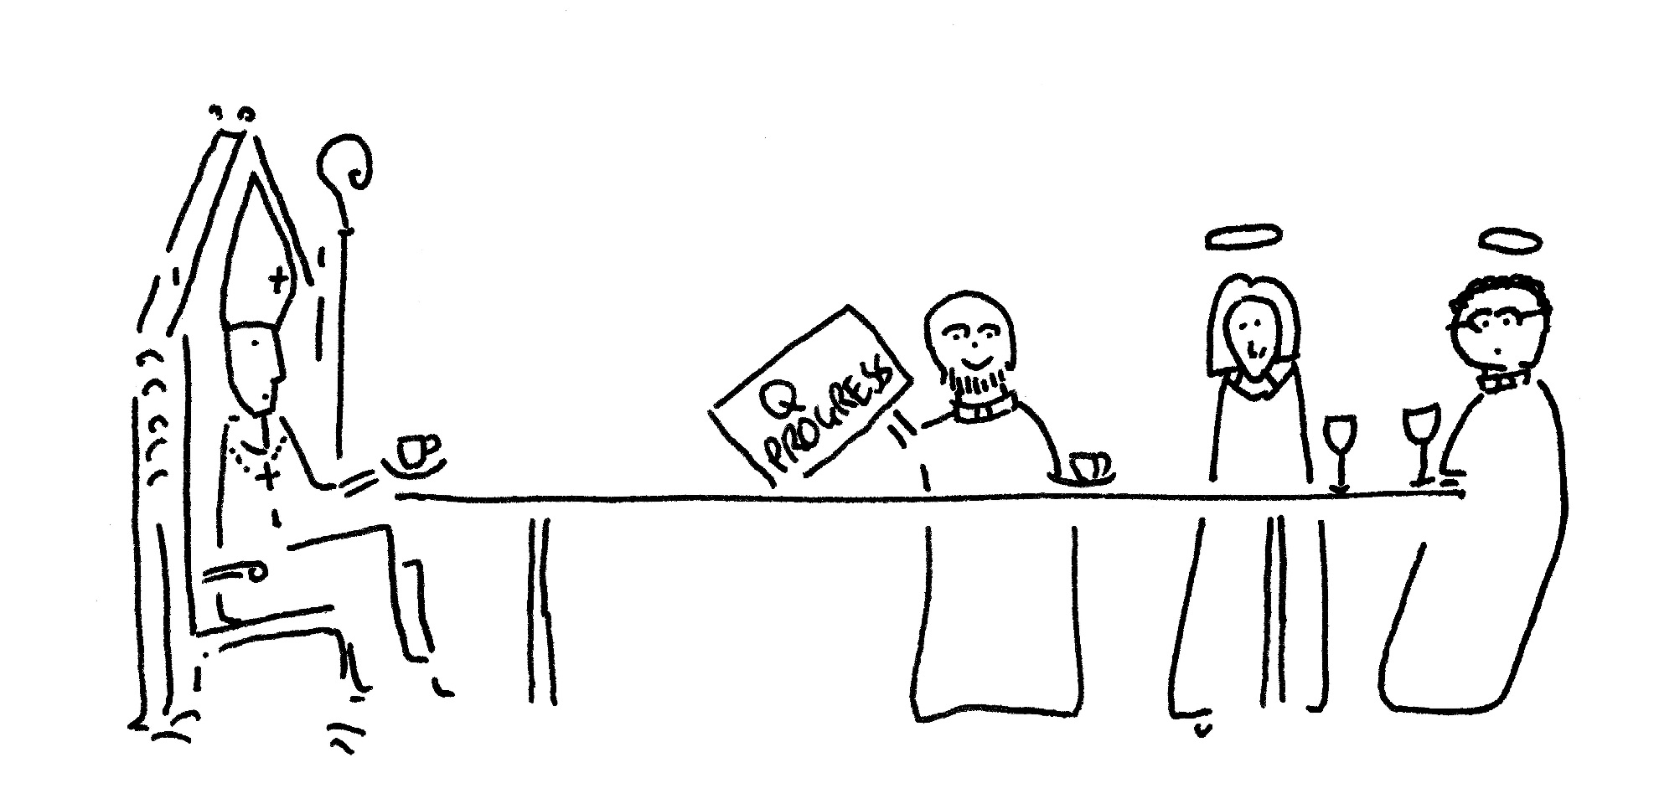
Bishop’s
Review
Notes:
At the Six Month Review the Bishop’s Staff Meeting receives a statement from the Archdeacon of Cornwall. They observe that the welcome work has gone well; and that the deanery student project is on course. However, Messy Church has been resisted by some within the congregations who agitate for more Eucharistic worship. Bishop’s Staff suggest that the benefice be offered the support of a change management / reconciliation / worship consultant. The Head of Church Growth Development speaks with the parish and this help is organised.

